Slide 1

Linear Regression is not just about Lines and Planes

Slide 2
Reference
Youtube on Dataset Noisy_Bowl
Youtube
Code

Slide 3
Load Noisy_Bowl

Slide 4
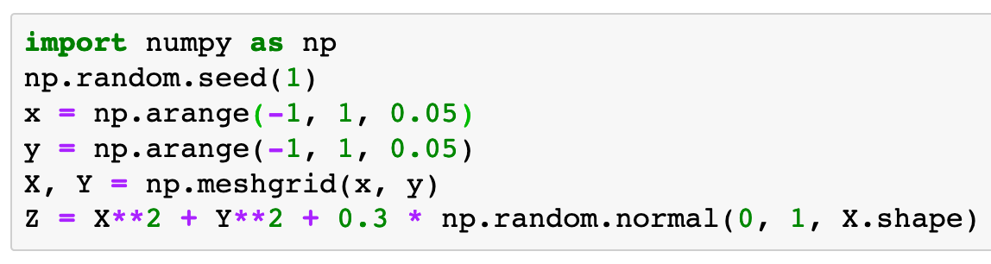

Slide 5
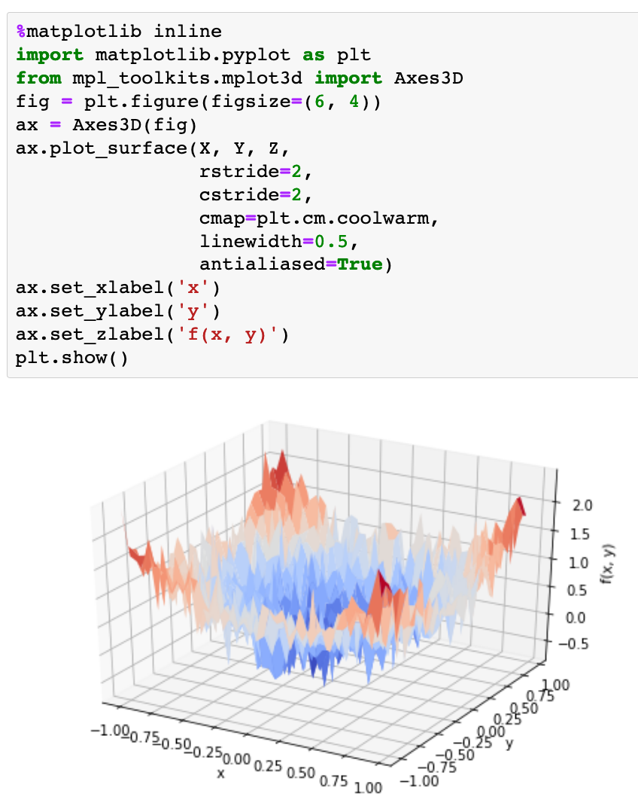

Slide 6
Load Noisy_Bowl Functional Form

Slide 7
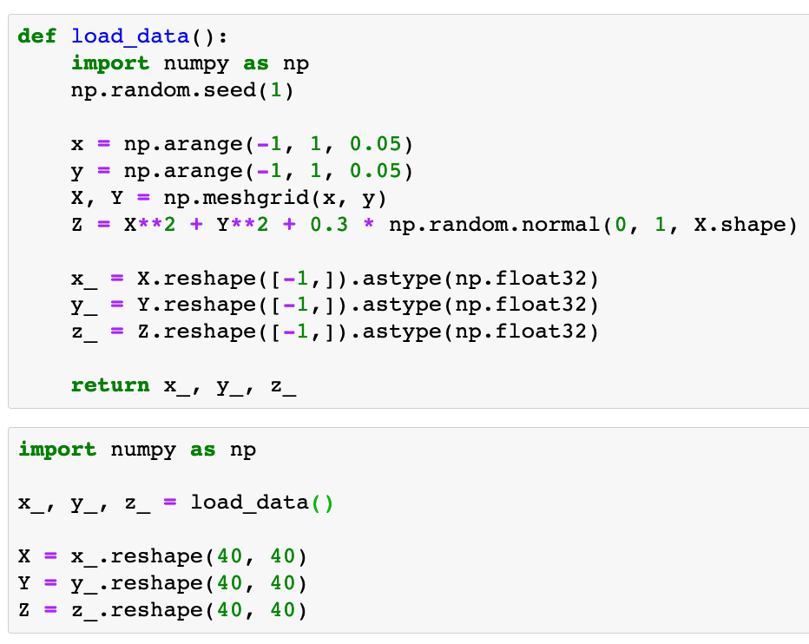


Slide 10
Fit Parabola

Slide 11
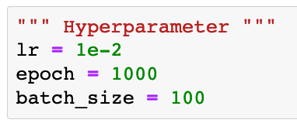

Slide 12


Slide 13
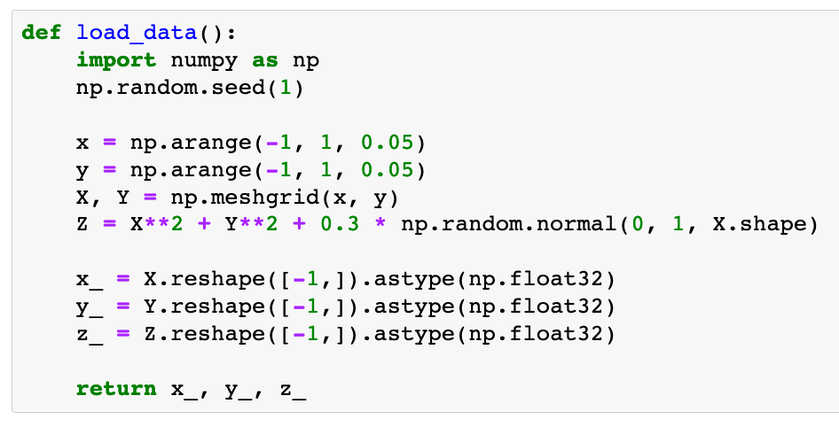

Slide 14
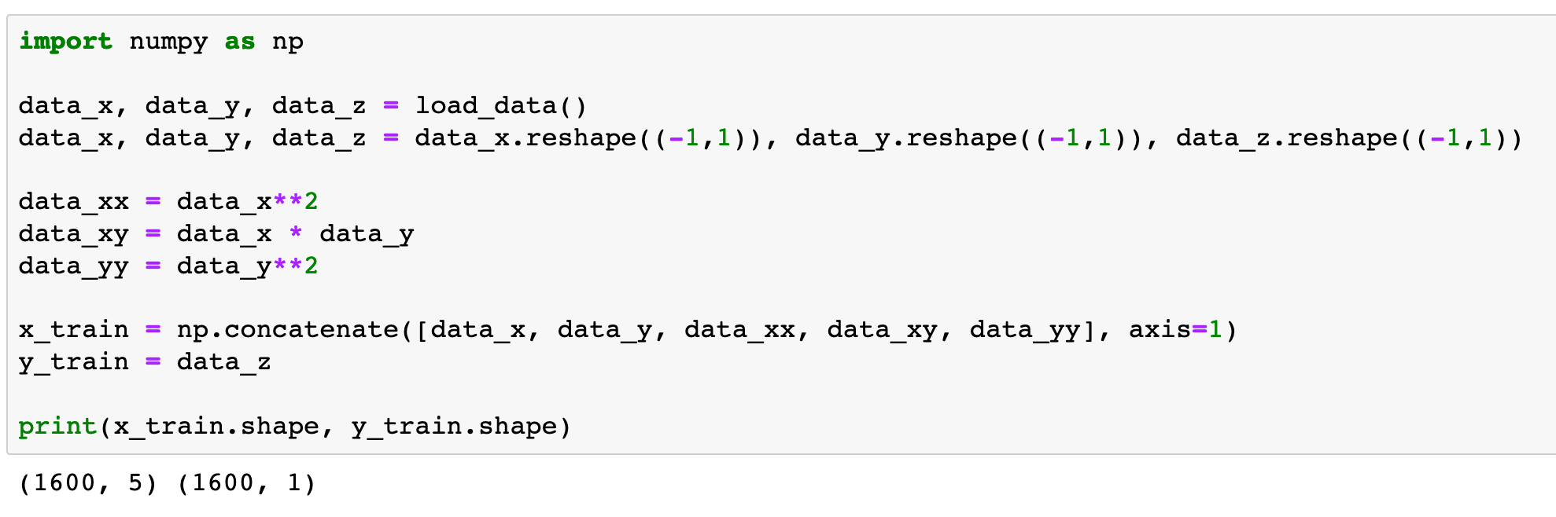

Slide 15


Slide 16
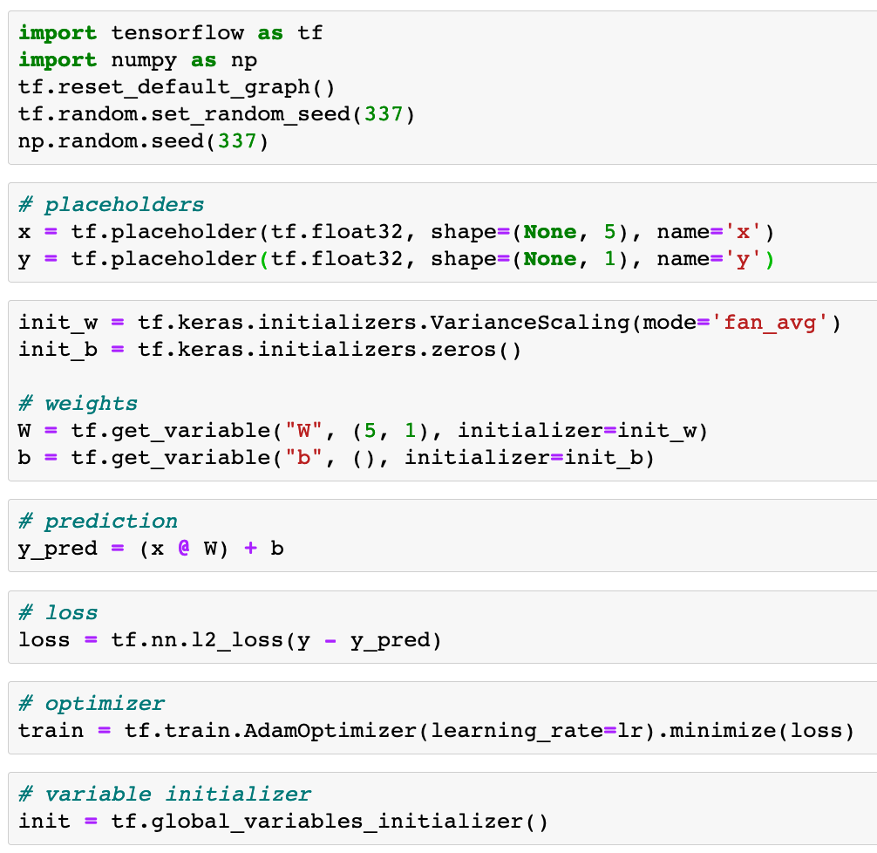

Slide 23


Slide 24
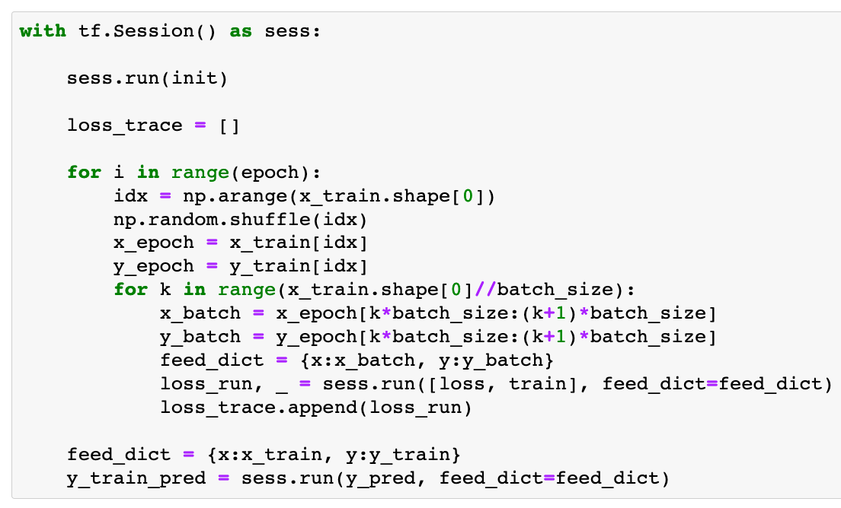

Slide 25


Slide 26
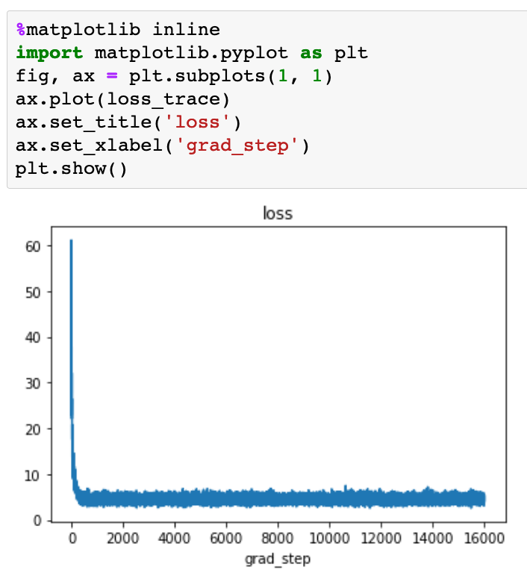

Slide 27
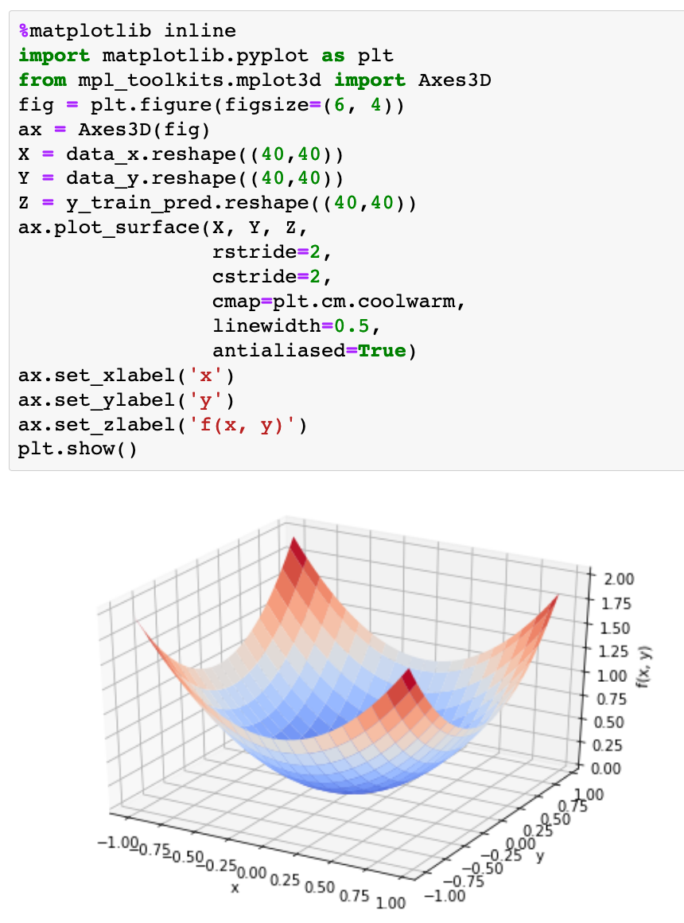

Slide 28
Now
Let’s Play with Code

